Slide 1


 | SILIGURI INSTITUTE OF TECHNOLOGY DEPARTMENT OF ELECTRICAL ENGINEERING
Presentation on _VOICE ASSISTANT
By (Group 1):
Sagar Mandal
Priyashree Nandi
Amit Kumar Ram
Rupa Sharma
Divya Gupta

Slide 2

Topics Voice Assistent
Introduction
Goals of the project
Future of the project
Conclusion
Reference

Slide 3
Introduction
A voice assistant is a digital assistant that uses voice recognition, language processing algorithms, and voice synthesis to listen to specific voice commands and return relevant information or perform specific functions as requested by the user . Based on specific commands, sometimes called intents, spoken by the user, voice assistants can return relevant information by listening for specific keywords and filtering out the ambient noise . While voice assistants can be completely software based and able to integrate into most devices, some assistants are designed specifically for single device applications, such as the Amazon Alexa Wall Clock. Today, voice assistants are integrated into many of the devices we use on a daily basis, such as cell phones, computers, and smart speakers. Because of their wide array of integrations, There are several voice assistants who offer a very specific feature set, while some choose to be open ended to help with almost any situation at hand.

Slide 4
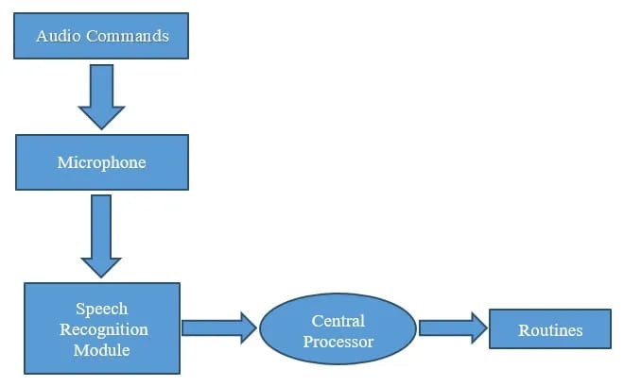
GOAL OF THE PROJECT
The work started with analyzing the audio commands given by the user through the microphone. This can be anything like getting any information, operating a computer’s internal files, etc. This is an empirical qualitative study, based on reading above mentioned literature and testing their examples. Tests are made by programming according to books and online resources, with the explicit goal to find best practices and a more advanced understanding of Voice Assistant.
Fig.1 shows the workflow of the basic process of the voice assistant. Speech recognition is used to convert the speech input to text. This text is then fed to the central processor which determines the nature of the command and calls the relevant script for execution
Fig.1

Slide 5
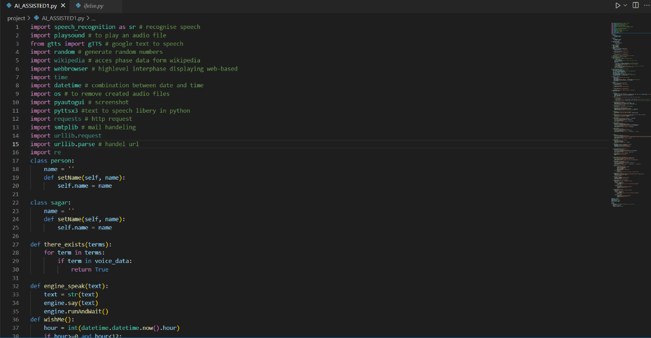
Short Part of Code

Slide 6

Output

Slide 7
FUTURE OF PROJECT
More efficient and faster operations — The ability to precisely communicate with technology using just your voice eliminates the need for error scans and instead allows for more accurate workloads at a faster pace. Convenience — Having your speaker or your computer recognise your voice from the outset means that after the initial set-up, the computer adapts to your voice and speaking pattern, reducing the need for tinkering and allowing for better communication and task management.

Slide 8
CONCLUSION
In this PROJECT “Voice Assistant Using Python” we discussed the design and implementation of Digital Assistance. The project is built using open source software modules with PyCharm community backing which can accommodate any updates shortly. The modular nature of this project makes it more flexible and easy to add additional features without disturbing current system functionalities.

Slide 9
REFERENCES
[1] https://extrudesign.com/virtual-assistant-using-python/
[2] https://www.geeksforgeeks.org/voice-assistant-using-python/
[3]https://alan.app/blog/voiceassistant-2/amp/#referrer=https://www.google.com&csi=0
[4] https://www.geeksforgeeks.org/play-sound-in-python/

